Slide 1
Introduction to Programming in Python
Ezekiel Adebayo Ogundepo (@gbganalyst)

Slide 2
Data Structure in Python

Slide 3
Data structure in Python
Apart from different data types such as integer, float, string and Boolean, Python also has data structure which include
List
Tuple
Set
Dictionary

Slide 4
Data structure in Python
Data structures are collection of data elements that are structured in some manner and are the core of Python programming language.

Slide 5
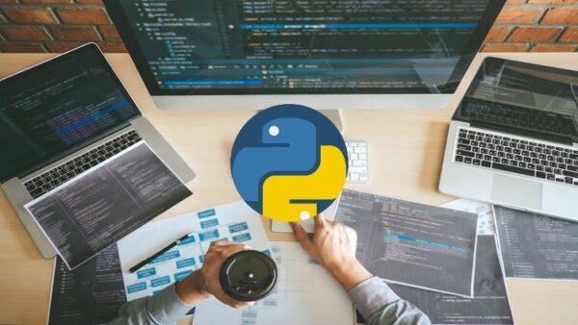
Lab session

